Slide 1
Advanced Language
Programming Course Design

Slide 2
Monopoly
谢东欣
黄嘉威
赵旻昆

Slide 3


Slide 4
Motivation
It is an appropriate choice to enhance our capability of problem analysis and programming skill since realizing it requires rigorous logical thinking and huge amounts of work.
We can also have a better understanding of object-oriented programming through doing this project due to the fact that it contains a variety of classes and inheritance relations etc.
Most people are familiar with this game as well as being fond of it, so that our project can draw people’s attention and gain their approval easily.
The topic also creates an opportunity for us to improve our innovative thinking ability. Because we can enrich our game’s functions and improve the practicality by standing on the players’ side since we already know the classical rules of the game.
There is no doubt that we students who major in computer science are always under great study pressure which does harm to our health and games like Monopoly can reduce our stress and bring happiness to us.

Slide 5
Project description
Monopoly is a multiplayer strategy board game which simulates the management process.
Development environment: Qt
Total lines: 5200 approx.

Slide 6
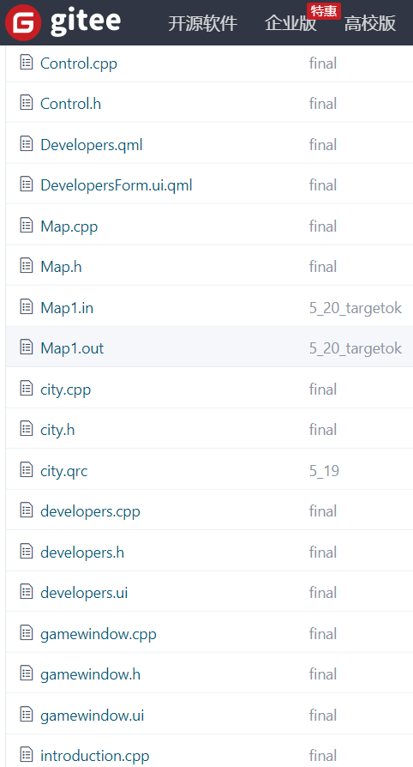
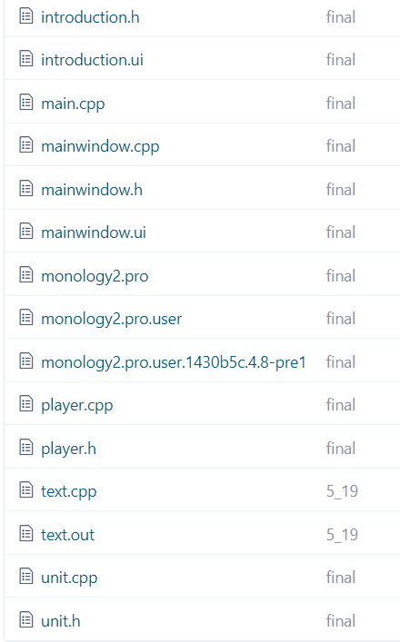
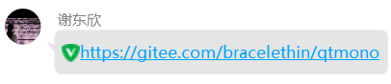

Slide 7
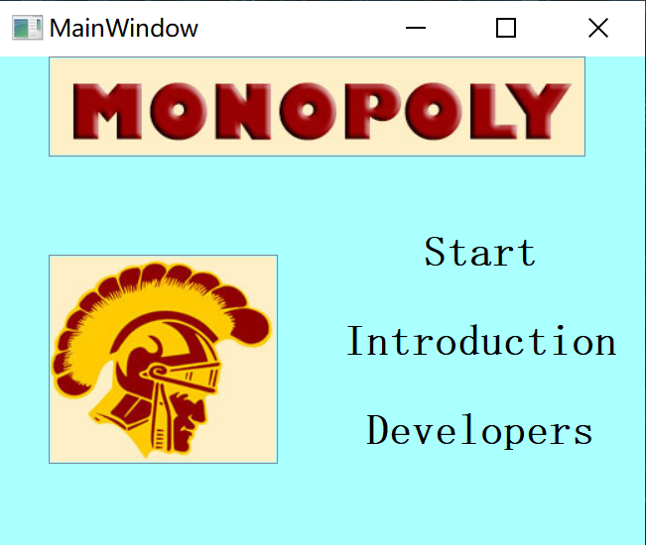

Slide 8
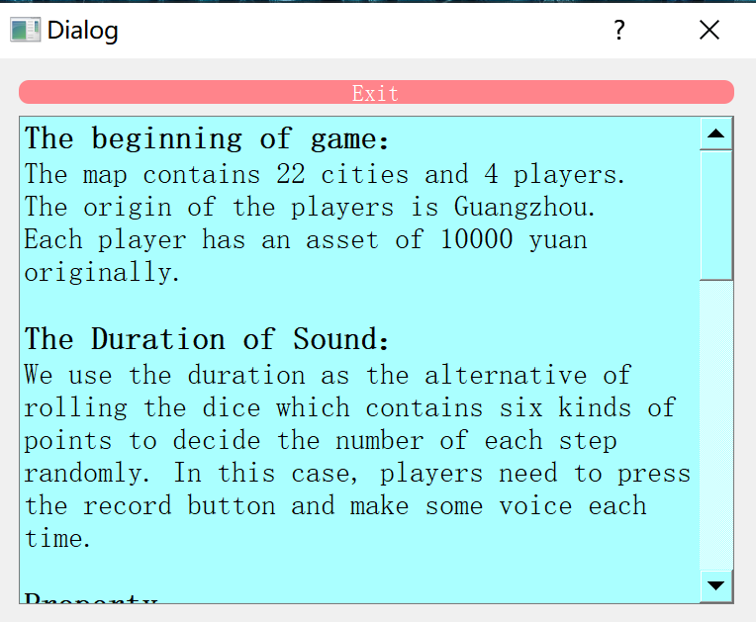

Slide 10
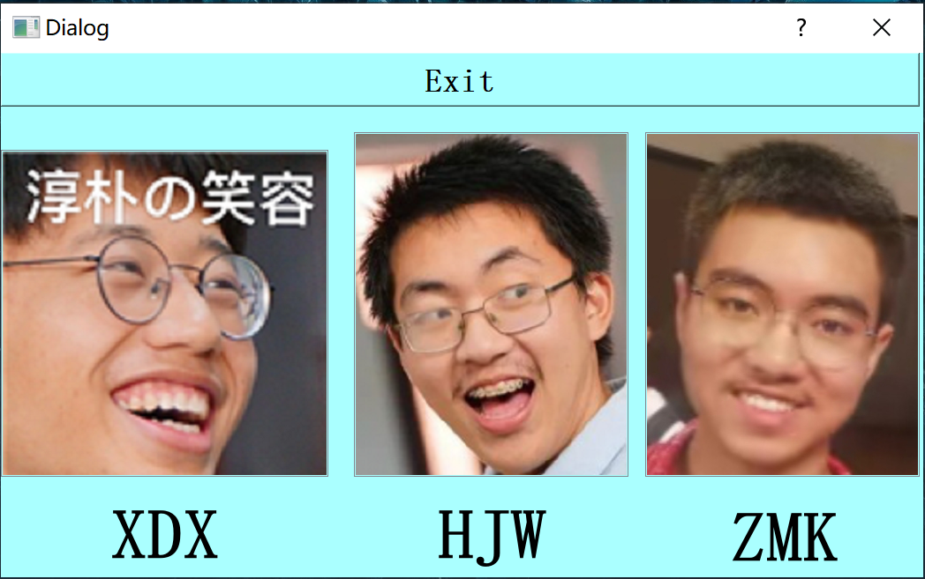

Slide 12
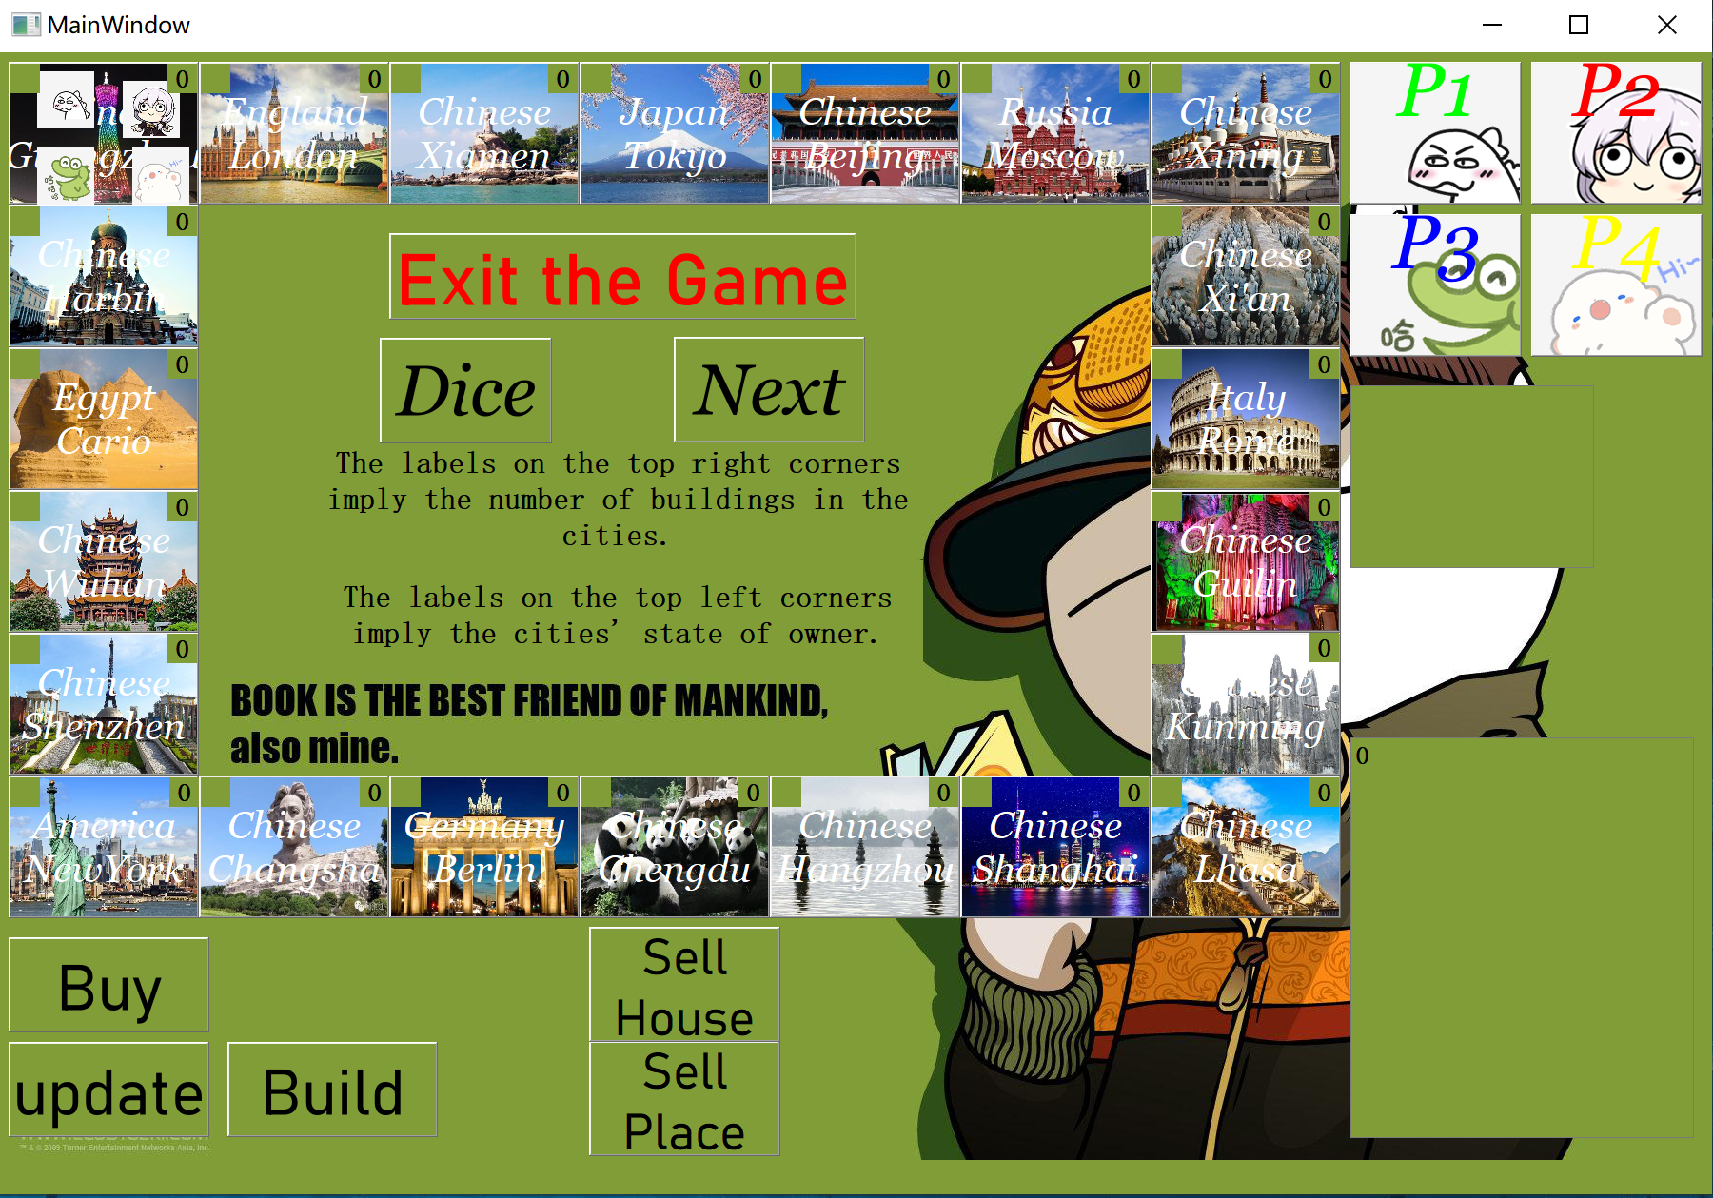
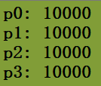
Prompt information

Slide 13
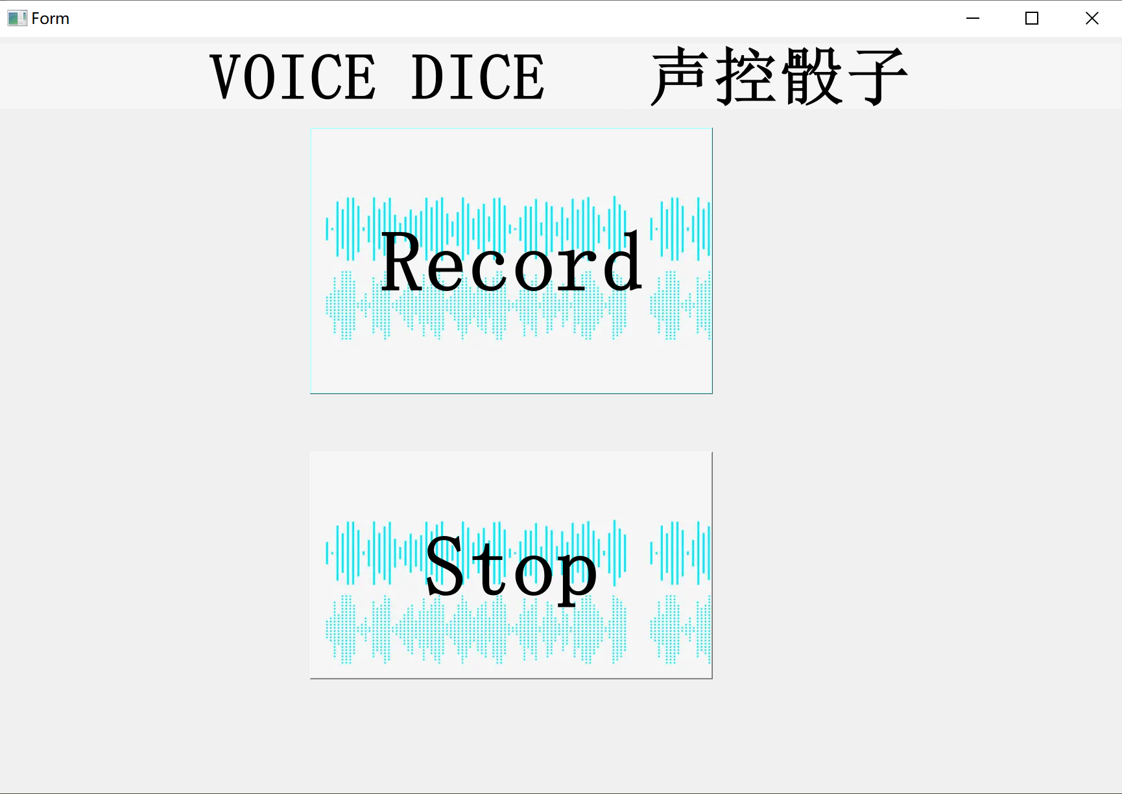

Slide 14
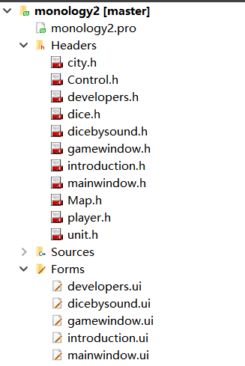
mainwindow
developers
Composition
introduction
Composition
gamewindow
dicebysound
Composition
Composition
Composition
Control
Composition
dice

Slide 15
Control
Composition
Composition
Map
Player
Composition
Unit
Inheritance
city

Slide 16
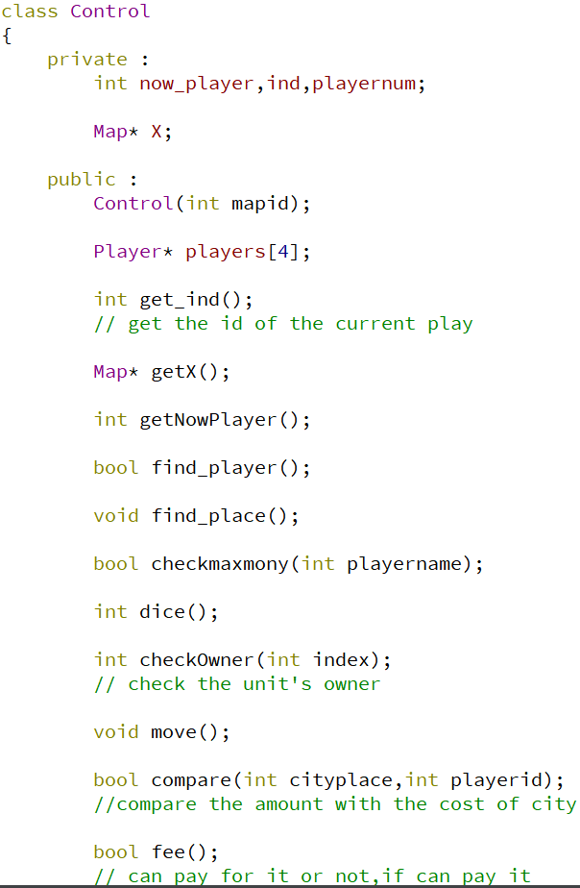
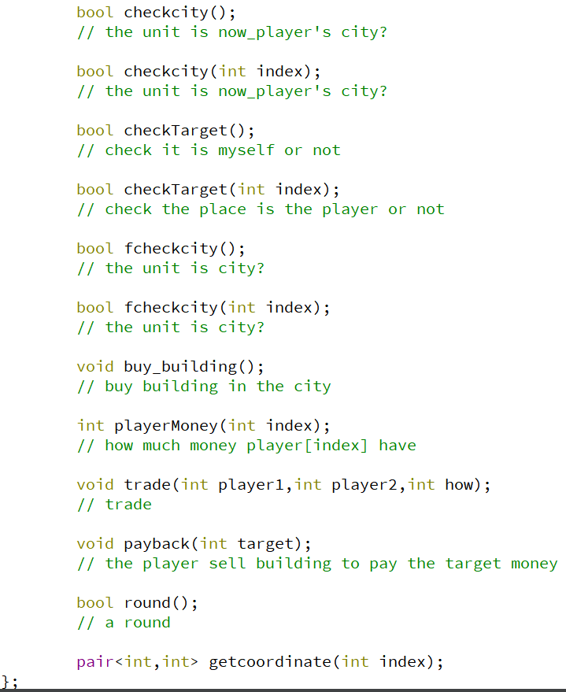
Basic architecture of
class Control
1. Button function
2. Process function
3. get function

Slide 17
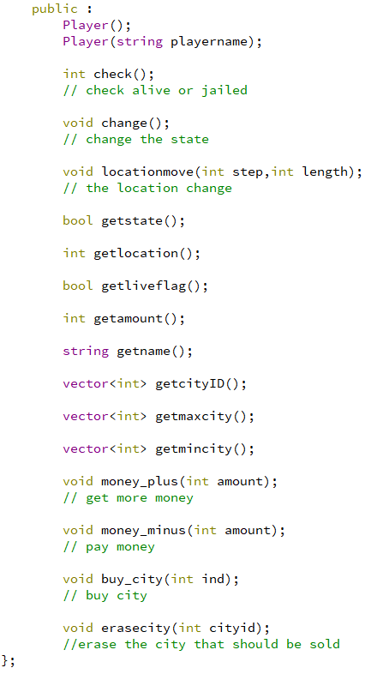
Basic architecture of class Player
1. Button function
2. calculate function
3. get function

Slide 18
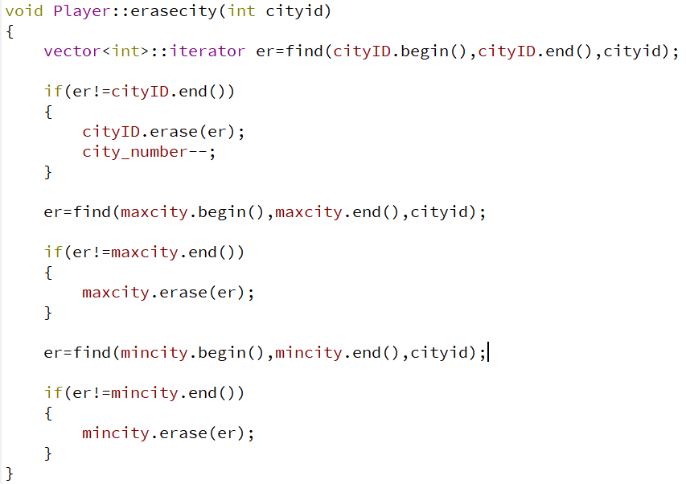
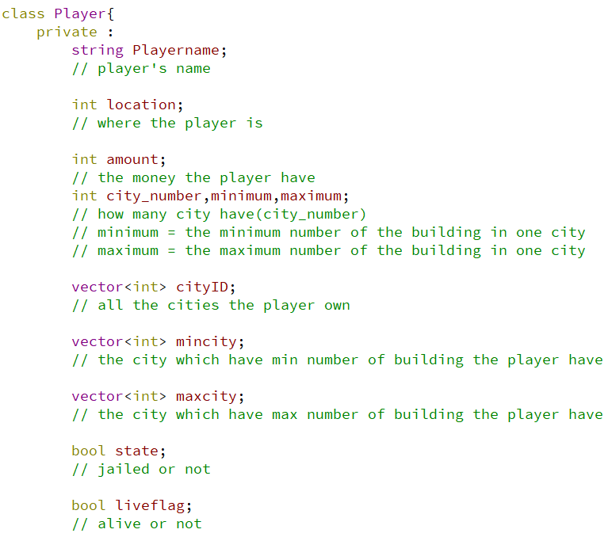

Slide 19
It’s time for
demonstration!

